Slide 1
Florida Project SEARCH Adult Model A Brief Overview
“This project is provided by the Florida Developmental Disabilities Council, Inc., supported in part by grant numbers 1901FLSCDD-01 and 2001FLSCDD-01 from the U.S. Administration for Community Living, Department of Health and Human Services, Washington, D.C. 20201. Grantees undertaking projects with government sponsorship are encouraged to express freely their findings and conclusions. Points of view or opinions do not, therefore, necessarily represent official ACL policy.”

Slide 2
RESPECT of Florida & FDDC
The Florida Developmental Disabilities Council (FDDC) entered into a contract with RESPECT of Florida to identify four Employment Centers that would partner with Project SEARCH to serve as the first adult cohorts.
RESPECT of Florida has a long history of providing individuals with disabilities the opportunity to work on State contracts that provide a wide-variety of commodities and services and has funded multiple microenterprises to assist individuals with developing their own businesses.
The Employment Centers identified for implementing the Florida Project SEARCH Adult Model were:
The Arc of Putnam County - Palatka
ARC of Martin County – Stuart
Goodwill Industries Suncoast - Clearwater
MacDonald Training Center – Tampa

Slide 3
Project SEARCH
The FDDC also entered into an agreement with the international, award winning, National Project SEARCH program for program licensure, training, and technical assistance.
Project SEARCH is a nine-month internship program for people with intellectual and developmental disabilities.
It is targeted for individuals whose goal is competitive employment.
The program takes place in a quality healthcare, hospitality, or other large business setting where total immersion in the workplace facilitates a learning-lab environment.
The interns will acquire employability and marketable work skills through their participation in three different 10-week internships, accompanied by a daily employability skills curriculum to reinforce critical competitive skills.
The interns work with a team that includes their family, an instructor, a skills trainer, and local and state agencies to create and reach their employment goal.
Project SEARCH currently has 705 active sites. They are in 48 states, 10 countries, and since 2010 have served 36,433 individuals. Over 70% of participants get employed (at least 16 hours a week).
In addition to supporting the planning, implementation, and staffing of these four new adult programs, the FDDC is also sponsoring research by Cincinnati Children’s Hospital Medical Center to evaluate the program.

Slide 4
Benefits of the Project SEARCH Model
Benefits to the Interns:
Participate in a variety of internships within the host business.
Acquire competitive, transferable, and marketable job skills.
Gain increased independence, confidence, and self-esteem.
Obtain individualized coaching, instruction, and feedback.
Develop linkages to Vocational Rehabilitation and other adult service agencies.
Benefits to the Host Business:
Access to a new, diverse, talent stream with skills that match labor needs.
Interns and employees with disabilities who serve as role models for customers.
Access to a demographic of the economy with intense buying power: people with disabilities represent one of the fastest growing market segments in the United States.
Increased regional and national recognition through marketing of this unique program.
Increased performance and retention in high-turnover, entry-level positions.

Slide 5
Our Four Sites
Each of our four sites partnered with a local business. This local business is the “host/training” site for the nine-month program.
Each site hired an “instructor” and a “skills trainer.” Per the model fidelity of Project SEARCH, our “instructors” did not have to be state certified. Florida’s VR required all staff to have previous experience with adults with disabilities.
Each site attempted to recruit 12 possible interns, with a focus of recruiting adults either currently in an Adult Day Training Center (ADT) or those who had participated in an ADT previously.
Based on Department of Labor (DOL) requirements our interns are not paid during this training, so RESPECT partnered with a secondary educational institution – the University of Wisconsin-Whitewater (UWW). UWW was selected due to their partnership with other Project SEARCH programs. Each intern will earn 2 college level credits upon completion of the program.

Slide 6
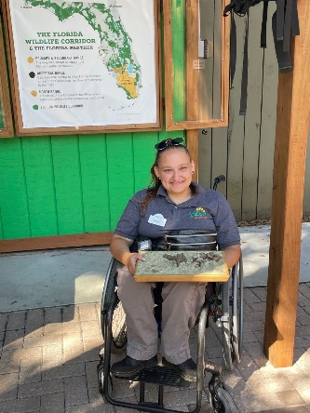
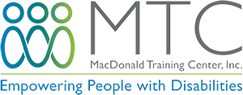
Our Four Sites: MacDonald Training Center
MacDonald Training Center
Host Business: ZooTampa in Tampa
In the first cohort, nine interns completed/graduated from the program.
Three of the interns were hired by the host site and three other graduates are currently working in the community.
MacDonald Training Center has a 75% success rate of individuals with disabilities achieving and maintaining employment!

Slide 7
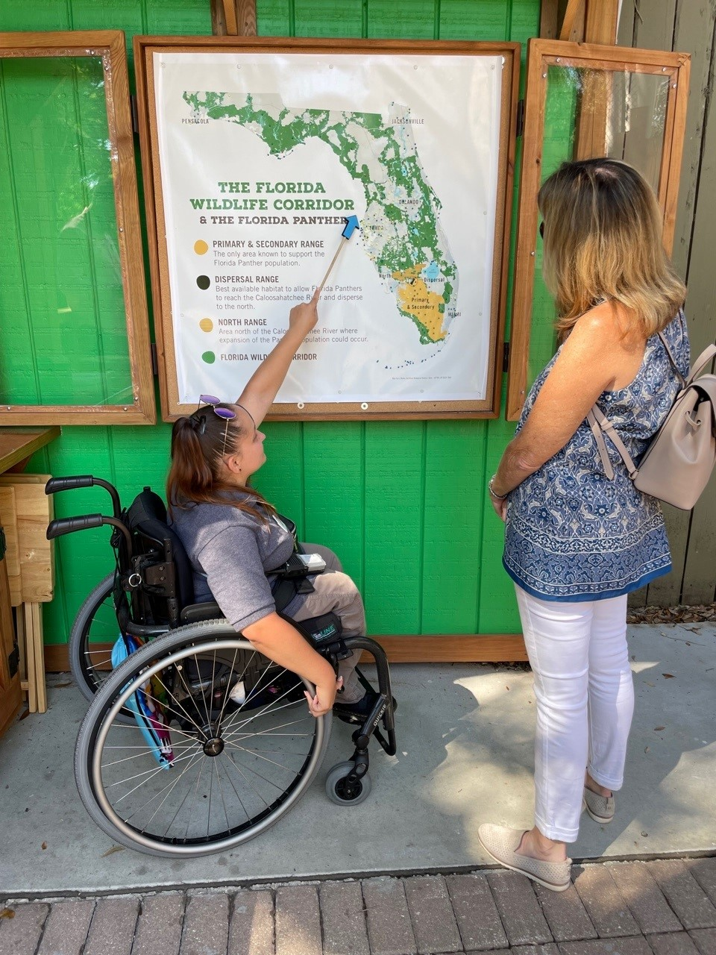
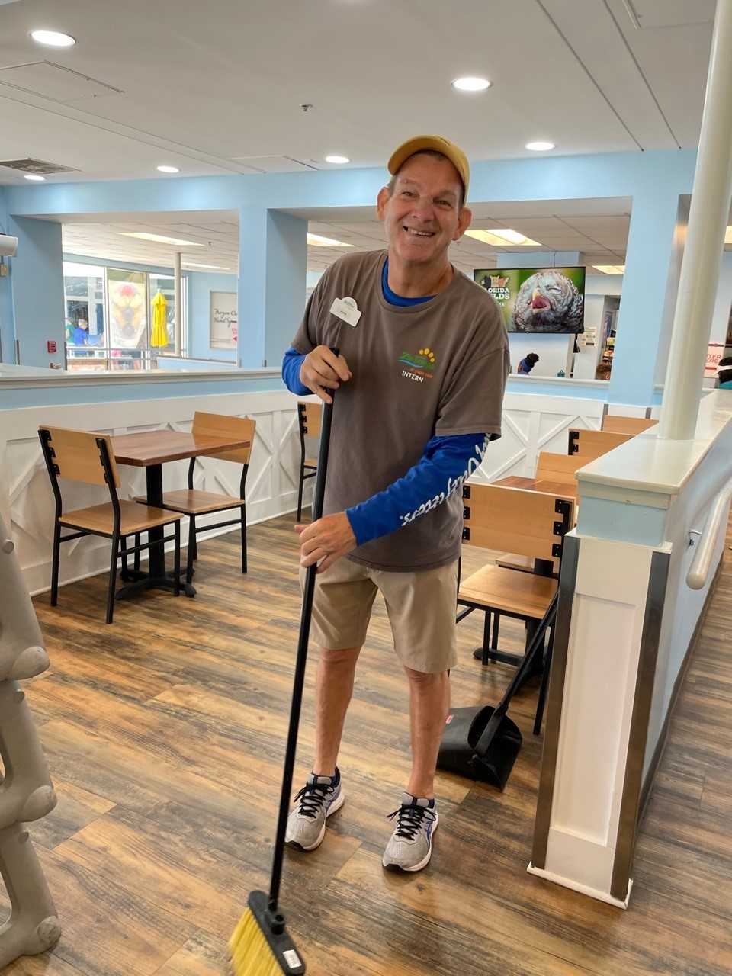
ZooTampa has provided MTC interns
with an on-site experience and opportunity
to learn transferable skills in the workplace.
9 month Internship
3 – Ten-week Rotations
Food & Beverage
Guest Experience
Retail
Rides
Park Quality
Maintenance
Aviary
Wallaroo Petting Zoo
Accounting
Development

Slide 8
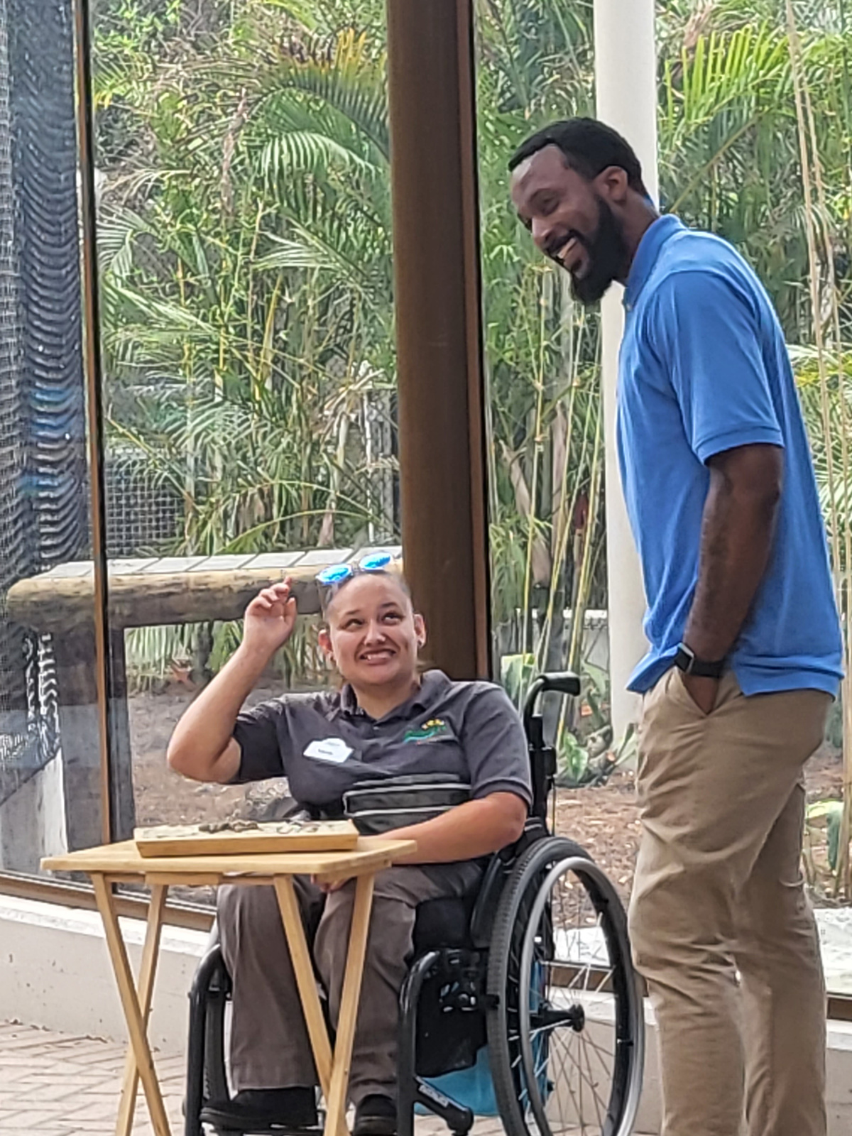
Project SEARCH
ZooTampa
MacDonald Training Center (MTC)
Adults with disabilities get new skills in Project SEARCH program | wtsp.com

Slide 9
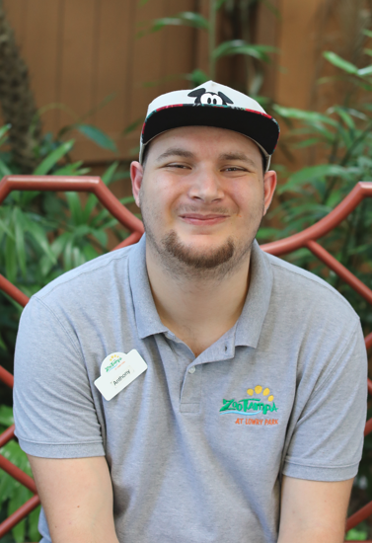
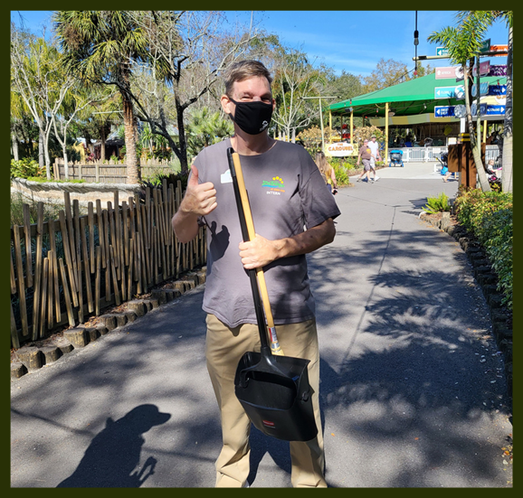
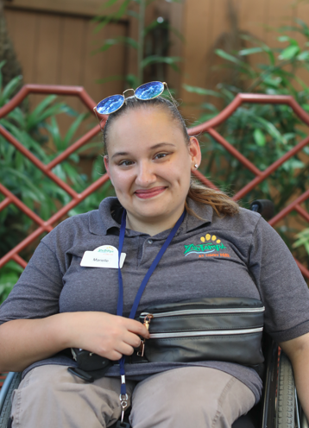
Meet the interns who were hired at ZooTampa!
Anthony Bartlett
John Pyros
Marielle Kaspar

Slide 10
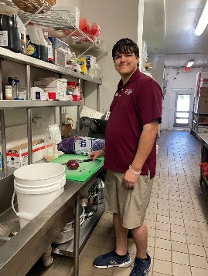
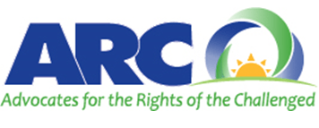
Our Four Sites: ARC of Martin County
ARC of Martin County
Host Business (Year 2): Sandhill Cove in Palm City
In the first cohort, five interns completed/graduated from the program.

Slide 11
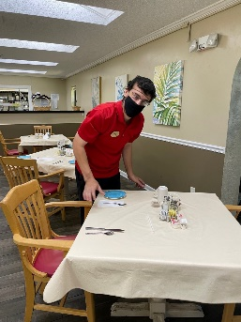
Our Four Sites: Goodwill Suncoast
Goodwill Suncoast
Host Business (Year 2): HCA Florida Pasadena Hospital
In the first cohort, six interns completed/graduated the program.
From the first cohort, two of the interns were hired by the host site, The Villas of Casa Celeste, and another intern was hired by a local restaurant.

Slide 12
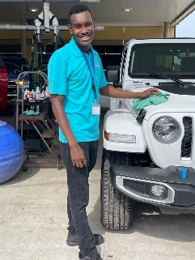
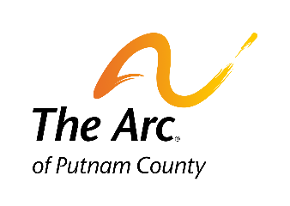
Our Four Sites: The Arc of Putnam County
The Arc of Putnam County
Host Business: Beck Automotive Group in Palatka
In the first cohort, eight interns completed/graduated from the program.
From the first cohort, two of the interns were hired by the host site.

Slide 13
Project SEARCH Funding Obstacle for Adult Sites
In Florida, the high school transition Project SEARCH (Youth) model is mostly funded by VR. VR provides funding to participating community disability agencies for items such as, but not limited to On-the-Job (OJT) experiences and supported employment placement and outcome benchmarks. This funding is meant to help cover the costs of the skills trainer that the agency provides. However, in this model the instructor is provided and paid for by the local school district.
In the Adult Model, the instructor is not covered by the local school district as the participants have already aged out of services from the school system.

Slide 14
Moving Forward
To move forward with the Adult Model, we found the need to braid/blend funding from multiple sources in order to try to cover the cost of the program.
Without the help of our partners, we would not have been able to overcome some of the funding barriers.
Vocational Rehabilitation has established billing codes and rates for the Adult Model, which is being rolled out.
The Agency for Persons with Disabilities is evaluating the use of EEP funds to serve individuals in the pre-enrollment category with employment as a goal in the Adult Model.
We are committed to addressing the funding obstacles in order to make the model whole to allow expansion of the model statewide. There are many community agencies across the state like MacDonald Training Center (MTC) that would like to begin offering this model in order to help Floridians with disabilities to obtain their employment goals.

Slide 15
Interns in Action During Various Rotations

